Slide 1

Cyber Defense Organization
Fall 2018 - Windows Defense

Slide 2
Stuff for intro...
https://www.youtube.com/watch?v=s_razQwH0Ok
https://www.dailymotion.com/video/x6vp9um

Slide 3

Word of the Week
YARA

Slide 4
WTF is…. YARA
YARA is a tool aimed at (but not limited to) helping malware researchers to identify and classify malware samples. With YARA you can create descriptions of malware families (or whatever you want to describe) based on textual or binary patterns. Each description, a.k.a rule, consists of a set of strings and a boolean expression which determine its logic.
https://yara.readthedocs.io/en/v3.7.0/a
TL;DR De Facto standard for malware examination

Slide 5
Agenda
Install a role
Play with Active Directory
Threat hunt
Run a powershell script

Slide 6
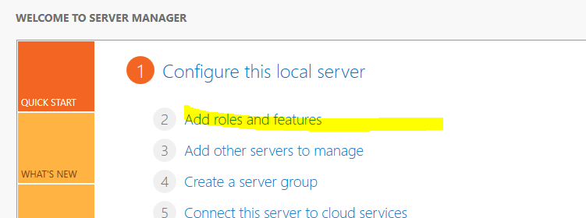
Install a feature

Slide 7
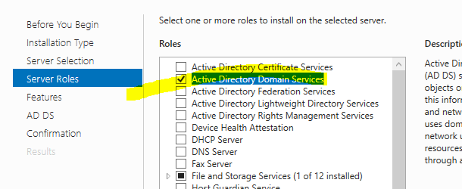
Click until

Slide 8
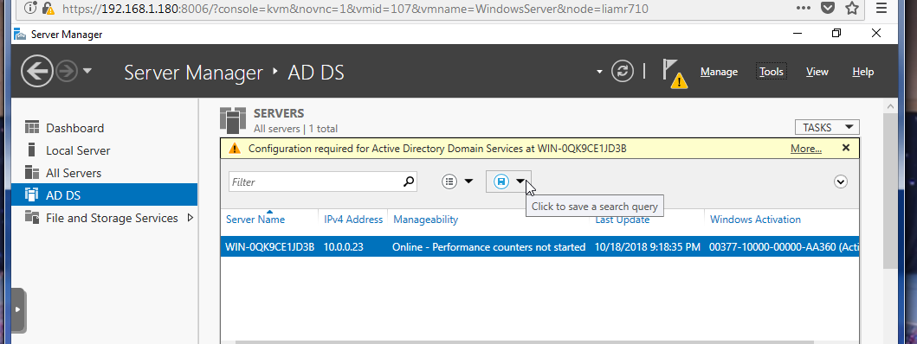
Next

Slide 9
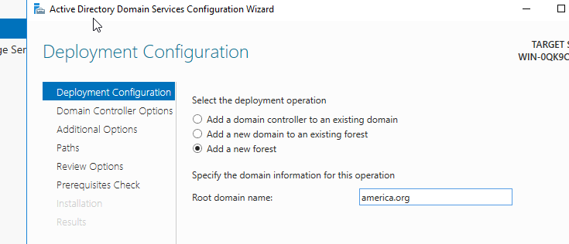

Slide 10
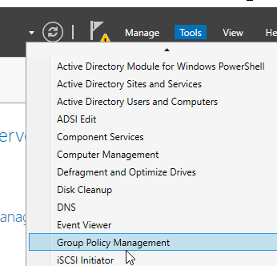
Lets Create Group Policy

Slide 11
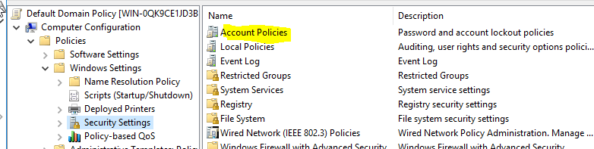
Group Policy
Once you have created the policy
Open new powershell
gpupdate /force
GPO - Account Lockout policy
Lockout-
Account lockout duration - 120 mins
Account lockout attempts - 5
Reset account counter lockout - 45 mins

Slide 12
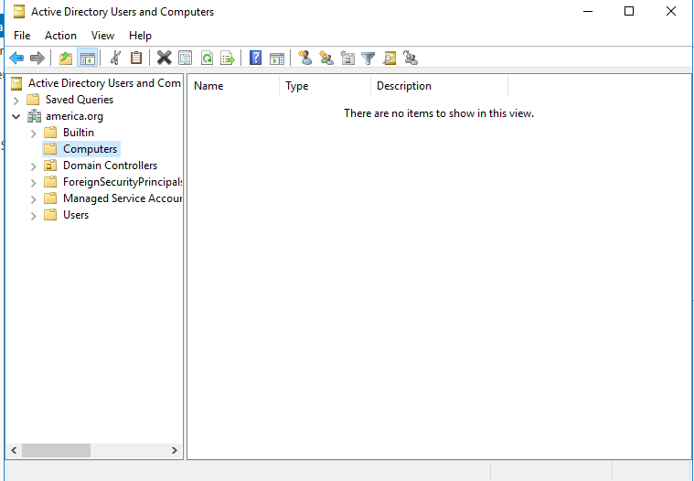
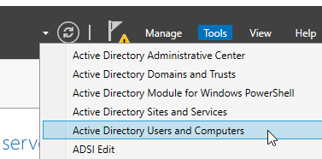
Make Some Users!

Slide 13
SysInternals
https://live.sysinternals.com/
Download:
Autoruns64.exe
procexp64.exe

Slide 14
Powershell Scripts!
Download AD Recon - https://github.com/sense-of-security/ADRecon
Start
powershell –ExecutionPolicy Bypass

Slide 15
UPDATES
Talk about your project - Workshop

Slide 16
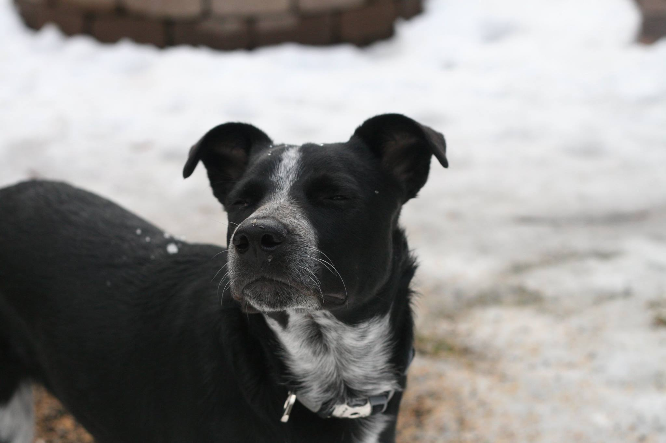


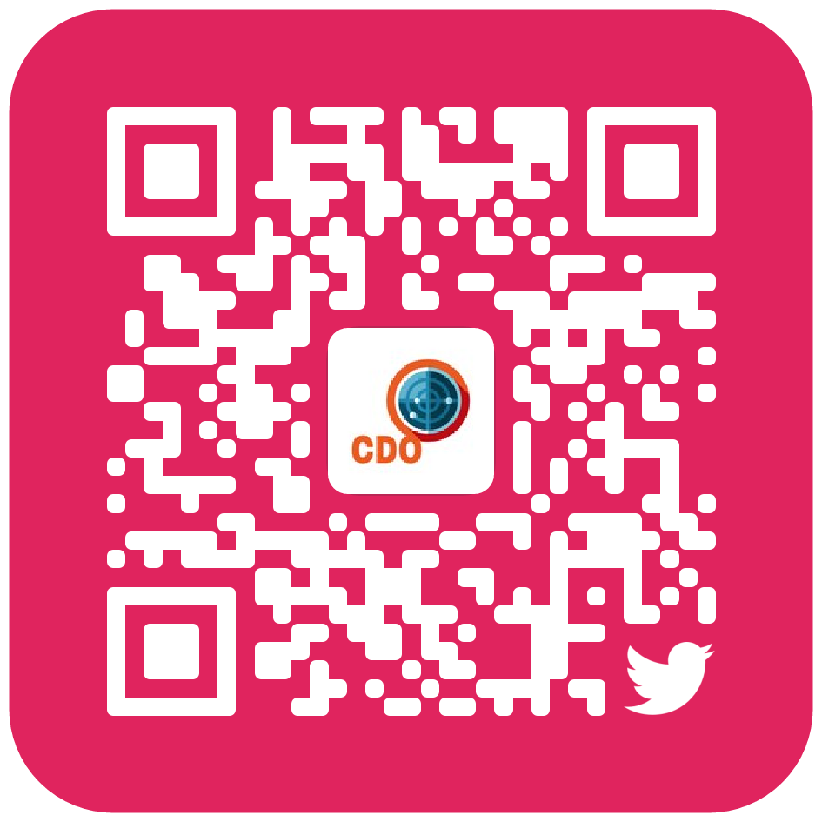
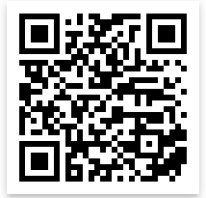
Cya Next week!
PWC 7:30PM Tuesday, BB129
Follow us on Twitter? Add on myInvolvement?
Introduction to Routers
- Friday 3pm BB121
CCDC Meeting
- Monday 7:30PM BB121

